Slide 1

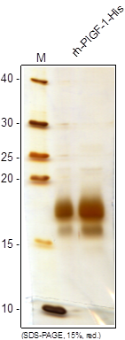
ReliaTech GmbH
Recombinant human PlGF-1/His
(Cat #300-017S / 300-017 / 300-018)
Fig. 1: SDS-PAGE analysis of recombinant human PlGF-1/His derived from insect cells. Samples were loaded in 15% SDS-polyacrylamide gel under reducing conditions and stained with Silver stain.
http://www.reliatech.de / orders@reliatech.de

